Slide 1
A study on the detection and validation of Protein-Protein Interaction Inhibitors for Cystic Fibrosis treatment using Machine Learning-driven virtual screening approach
DOCTORAL ADVISORY COMMITTEE MEETING
Research Guide:
Dr. Manoov R
Assistant Professor Senior,
Department of Computer Science
and Engineering,
Vellore Institute of Technology,
Vellore.
Research Scholar:
Ms. Dhivya G
24PDT0002,
School of Biosciences and Technology,
Vellore Institute of Technology,
Vellore.

Slide 2
Contents
Theoretical Background
Problem statement
Research Gap
Research Motivation
Objectives
Previous Research
Methodology / Work Plan
Proposed Course work

Slide 3
Theoretical Background
Cystic Fibrosis (CF) is a recessive genetic disease that is caused by mutation in the CFTR protein¹.
CF patients affected with chronic lung infections are mainly due to the pathogen, Pseudomonas aeruginosa (Pa).
Cystic fibrosis transmembrane conductance regulator (CFTR) protein gets mutated in the F508del position which leads to life-threatening lung infection².
Mutation in the defective CFTR gene impairs Cl⁻ ion transport, disrupts fluid homeostasis across epithelial membranes.
Results in thick mucus formation in affected organs which damages lungs.
Existing treatments like Lumacaftor and Ivacaftor have limited efficiency, high cost, and variable patient response, highlighting the need for new therapeutics.

Slide 4
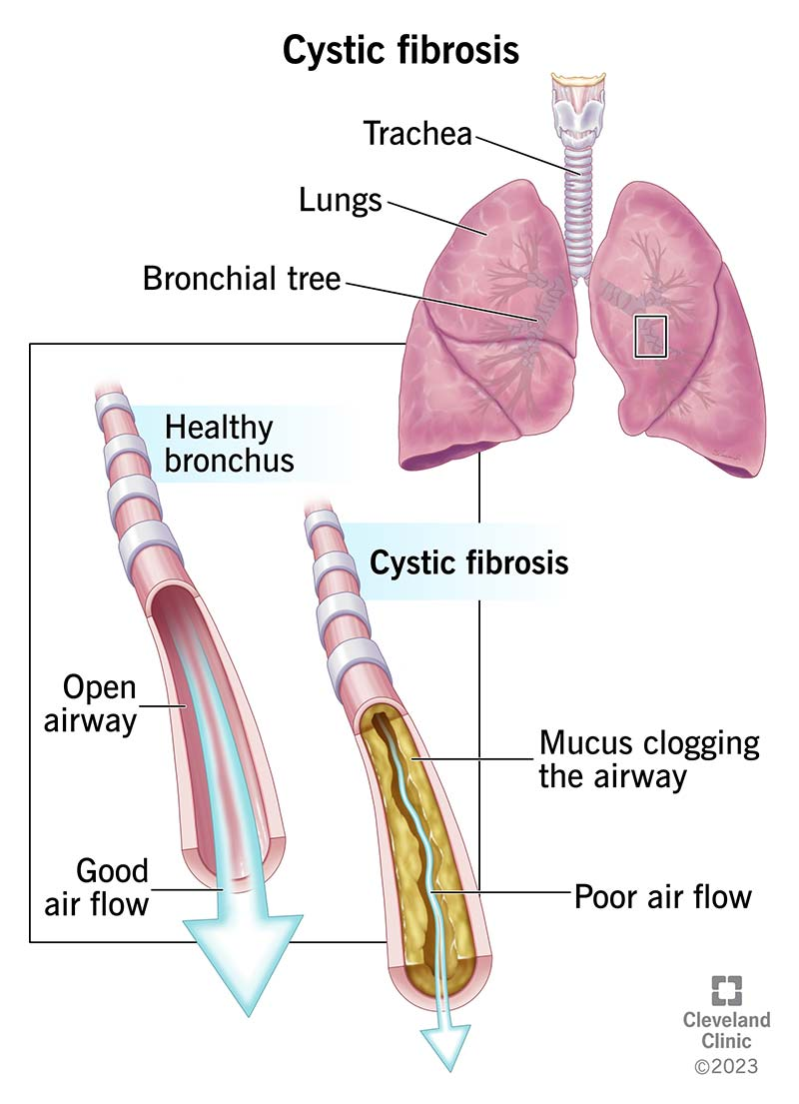
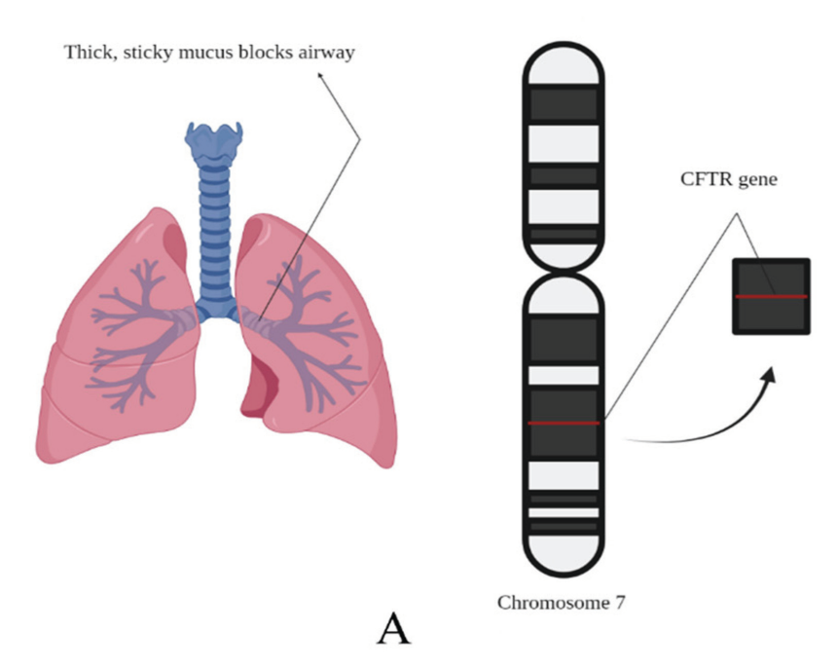
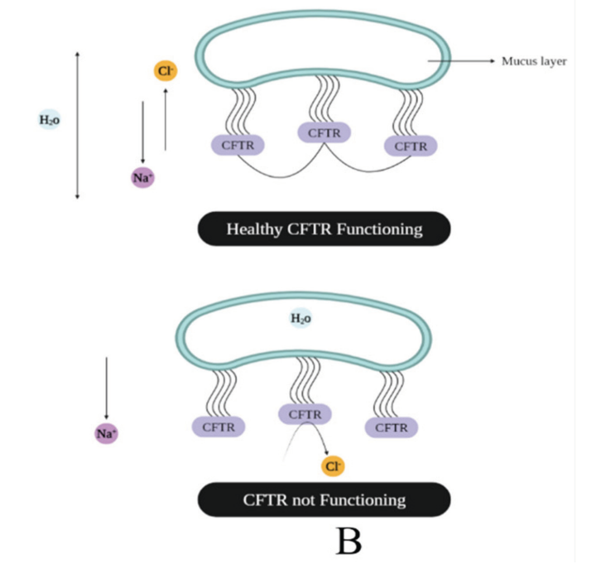
Cystic Fibrosis – Normal / Dysfunction
(A) Cystic fibrosis and the CFTR gene in chromosome seven whose malfunction is responsible for the disease.
(B) Functioning of healthy and unhealthy CFTR

Slide 5
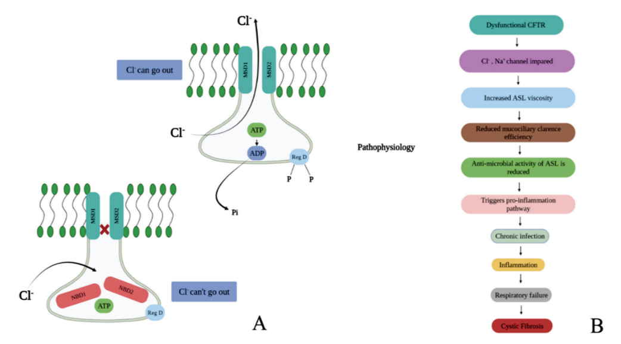

Cystic Fibrosis and its mechanism
Dysfunctional CFTR
Cl⁻, Na+ channel impaired
Increased ASL vicosity
Reduced mucocillary clearance efficiency
Anti-microbial activity of ASL is reduced
Triggers pro-inflammation pathway
Chronic infection
Inflammation
Respiratory failure
Normal CFTR in which the Cl- can pass; as a result, the concentration and ASL viscosity are maintained, and when Cl- cannot pass, CF can be caused
Cystic fibrosis
(B) pathophysiological process

Slide 6
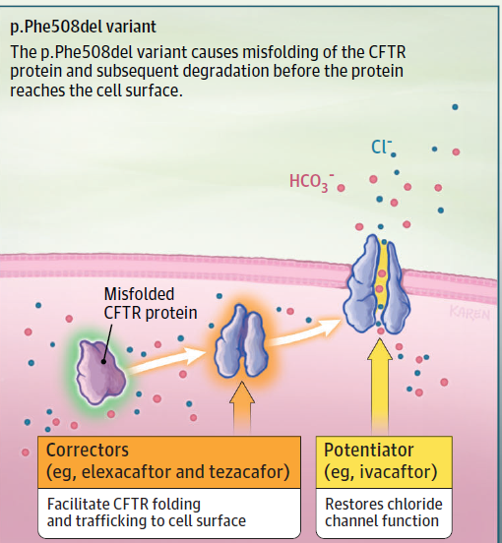
Problem statement: Protein - protein interactions (PPIs)
PPIs are therapeutic macromolecular targets.
PPIs play a crucial role in CFTR misfolding, degradation and defective trafficking, particularly in the F508del mutation³.
F508del mutation - Inappropriate modifications after translation are thought to be the cause of a protein's inability to be bound to the proper cellular site.
Current treatments like CFTR modulators have helped many patients, but they work only for limited types of gene mutation.
CFTR variants in cystic fibrosis
Image source: Thida et al., 2023. Cystic Fibrosis A Review, JAMA, Volume 329, Number 21 1859

Slide 7
Enzymes, ion channels, and receptors act as proteins for target-based drug discovery.
PPIs are key targets to expand the druggable proteome⁴, which therapeutically tackle various diseases⁵.
PPI targeting drugs are advantageous than vaccines for mutations in genomes that results in immune evasive properties.
Identification of Small-molecule inhibitor
Image source: Yoon, H., Rutter, J. C., Li, Y. D., & Ebert, B. L. (2024). Induced protein degradation for therapeutics: past, present, and future. The Journal of Clinical Investigation, 134(1).

Slide 8
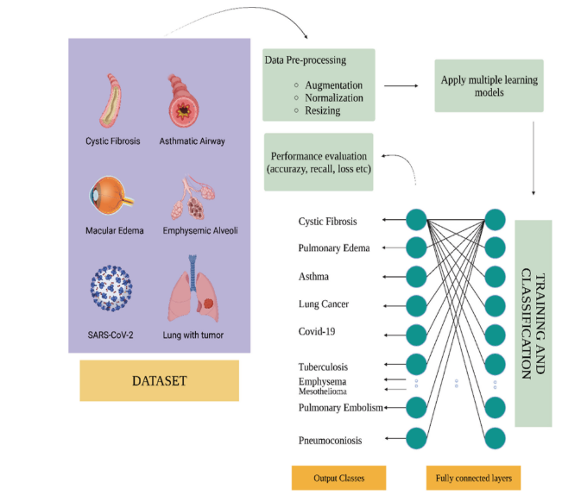
Importance of Machine Learning in Cystic Fibrosis
Machine learning have emerged as powerful tools in virtual screening and drug discovery but are under utilized in identifying PPI inhibitors for Cystic fibrosis.
CFTR- PPI interaction databases have not been used to develop predictive models.
This study proposes developing an ML-driven platform for predicting, screening, and validating novel PPI inhibitors for cystic fibrosis treatment.
Artificial Intelligence in Cystic fibrosis

Slide 9
Research Gap
Machine learning based virtual screening approach identifies and prioritize small-molecule inhibitors targeting CFTR-associated protein-protein interactions for Cystic fibrosis treatment.
Research Motivation
Leverage Machine Learning to identify novel PPI inhibitors.
Develop cost-effective and reduced timeline targeted therapies for CF.
Establish a computational pipeline for CF drug discovery and validation.

Slide 10
CFTR-Interacting Proteins for targeting PPI Inhibitor
Protein | Full Name | Biological Role | Relevance to CFTR & PPI Targeting
CAL | CFTR-Associated Ligand | Adaptor protein promoting CFTR degradation via lysosomal trafficking | Competes with NHERF1 for CFTR binding - inhibition could prolong CFTR membrane stability
HSP90 | Heat Shock Protein 90 | Molecular chaperone that stabilizes folding intermediates | Stabilizes misfolded CFTR - inhibition may alter folding trajectory and degradation outcomes
NHERF1 | Stress-Induced Phosphoprotein1 | Co-chaperone linking HSP70 and HSP90 in CFTR folding complexes | Mediates CFTR chaperone complex - PPI disruption may modulate folding pathway

Slide 11
Objectives
Aim
To develop a machine learning based platform to identify and validate PPI inhibitors targeting CFTR in Cystic Fibrosis and assess their drug potential through computational methods.
To curate and preprocess a high-quality dataset of protein-protein interactions (PPIs) relevant to CFTR dysfunction in Cystic Fibrosis.
To design and train machine learning models to predict small molecules with high potential to inhibit CFTR-related PPIs.
To implement a virtual screening pipeline integrating the trained ML models for rapid prioritization of top candidate inhibitors.
To validate the top-ranked candidate inhibitors through molecular docking, dynamics simulations, and binding free energy analysis.
To evaluate the therapeutic potential of identified inhibitors through ADMET profiling.

Slide 12
Objective 1
Objective 1: To curate and preprocess a high-quality dataset of protein-protein interactions (PPIs) relevant to CFTR dysfunction in Cystic Fibrosis.
Previous Research
Author/Year | Title | Journal | Relevant Research Gap | Key findings
David et al., 2018 | Data Resource Profile: The UK Cystic Fibrosis Registry | International Journal of Epidemiology | Underuse of large-scale clinical data for CF research. | Provides longitudinal clinical data on >12,000 CF patients; supports real-world outcome and drug studies.
Melissa et al., 2023 | A Proteomic Survey of the Cystic Fibrosis Transmembrane Conductance Regulator Surfaceome | International Journal of Molecular Sciences | Limited understanding of CFTR’s surface interactors and variant-specific PPIs. | Identified 113 high-confidence CFTR surface interactors.
Iazzi et al., 2022 | Proximity Profiling of the CFTR Interaction Landscape in Response to Orkambi | Int. J. Mol. Sci. | Limited understanding of CFTR interaction changes with ∆F508 mutation and drug modulation | Identified 474 WT and 626 ∆F508-CFTR interactors using BioID. Orkambi altered specific interactions.

Slide 13
Methodology/ Work plan
Objective 1
Identify key targets for CFTR -PPI inhibitors
[CAL, HSP90, NHERF1]
Data Source Identification – BioGRID, STRING, PDB
Extract PPI Data
Filter and curate, the Dataset
Annotate Protein Functions and Pathways
Post translational modifications (trafficking, folding, degradation, channel function)
Format and Standardize the Dataset
Integration of CFTR Mutation Dataset

Slide 14
Objective 2
Objective 2: To design and train machine learning models to predict small molecules with high potential to inhibit CFTR-related PPIs.
Previous Research
Author/Year | Title | Journal | Relevant Research Gap | Key findings
Wang et al., 2022 | Advanced graph and sequence neural networks for molecular property prediction and drug discovery | Bioinformatics | Lack of comprehensive and customized tools integrating both graph and sequence models for molecular property prediction, especially on imbalanced datasets | Developed AdvProp, a suite of ML models including ML-MPNN and contrastive-BERT; achieved top performance with improvements in ROC-AUC and PRC-AUC.
Díaz-Eufracio & Medina-Franco, 2022 | Machine Learning Models to Predict Protein–Protein Interaction Inhibitors | Molecules | Limited use of ML to classify PPI inhibitors using molecular fingerprints despite the availability of PPI data | Random Forest with ECFP4 fingerprints gave the best performance; provided a pipeline for reproducible ML modeling; ensemble models improved classification of PPI inhibitors.
Tang W et al, 2024 | In silico discovery of potential PPI inhibitors for anti-lung cancer activity | Frontiers in Chemistry | AI/ML-driven in silico workflow for PPI inhibitor identification and validation | Developed a workflow integrating pharmacophore modeling, virtual screening, molecular dynamics, and MM-GBSA to identify potential PPI inhibitors.

Slide 15
Previous Research
Objective 2
Author/Year | Title | Journal | Relevant Research Gap | Key findings
Philipp et al., 2024 | AI-guided pipeline for protein–protein interaction drug discovery identifies a SARS-CoV-2 inhibitor | Molecular Systems Biology | Lack of integrated AI pipelines for PPI-targeted drug discovery | Created an AI-ML workflow integrating AlphaFold-Multimer and ultra-large virtual screening for novel PPI inhibitors.
Kim et al, 2021 | Bayesian neural network with pretrained protein embedding enhances prediction accuracy of drug–protein interaction | Bioinformatics | Deep learning models need large datasets; uncertainty in predictions is underutilized | Combined transfer learning and Bayesian inference to improve DTI prediction accuracy; uncertainty quantification helps prioritize reliable predictions.
Agyemang et al, 2020 | Multi-view self-attention for interpretable drug–target interaction prediction | Journal of Biomedical Informatics | Limited interpretability of deep learning-based DTI models and over-reliance on single descriptors | Proposed a multi-view self-attention model combining multiple compound and protein features; achieved competitive performance and interpretability for kinase datasets.

Slide 16
Methodology/ Work plan
Objective 2
Curated Dataset of Known PPI Inhibitors – ChEMBL, iPPI-DB
Data Preprocessing: Remove duplicates and standardize SMILES
Generation of Molecular Descriptors from SMILES Chemprop/Deepchem
Selection of ML model
Model Training
Model Evaluation (AUROC, Accuracy, F1-score) and Interpretation

Slide 17
Objective 3
Objective 3: To implement a virtual screening pipeline integrating the trained ML models for rapid prioritization of top candidate inhibitors.
Previous Research
Author/Year | Title | Journal | Relevant Research Gap | Key findings
Kumar & Acharya, 2022 | Machine intelligence-driven framework for optimized hit selection in virtual screening | Journal of Cheminformatics | Low accuracy and high false positives in traditional VS; lack of ML (CS-PS) based frameworks | Developed A-HIOT (Automated hit identification and optimization tool) framework integrating chemical and protein space; achieved ~90% accuracy in hit optimization; outperformed conventional ML/DL methods.
McCloskey et al., 2020 | Machine Learning on DNA-Encoded Libraries: A New Paradigm for Hit Finding | Journal of Medicinal Chemistry | Underutilization of DEL data due to manual bias and limited scalability | ML models (GCNNs) trained on DEL data identified potent inhibitors (IC50 <10nM) for diverse targets; high hit rates (up to 72%) in large libraries.
Chandak & Wong, 2021 | EDock-ML: A web server for using ensemble docking with machine learning to aid drug discovery | Protein Science | Lack of theory and guidance for using ensemble docking results effectively | Introduced EDock-ML, combining ensemble docking with ML (RF, SVM, LR, KNN); improved prediction of actives using protein-specific models.

Slide 18
Previous Research
Objective 3
Author/ Year | Title | Journal | Relevant Research Gap | Key findings
Zhang et al, 2021 | An Integrated Deep Learning and Molecular Dynamics Simulation-Based Screening Pipeline Identifies Inhibitors of TIPE2 | Frontiers in Pharmacology | No known inhibitors for TIPE2 (Tumor necrosis factor of cancer) despite its therapeutic potential in cancer and inflammation | Identified 4 lead compounds from deep learning + MD pipeline.
Graff et al., 2021 | Accelerating High-Throughput Virtual Screening via Molecular Pool-Based Active Learning | Chemical Science | Massive VS libraries are computationally expensive; need efficient sampling | Active learning with D-MPNN identified 90%+ top hits from 100M library; greatly reduced VS cost while retaining accuracy.
Samad et al., 2023 | Identification of novel inhibitors for SARS-CoV-2 using ML-based virtual screening, molecular docking and MD simulation | Frontiers in Molecular Biosciences | Lack of specific antivirals for SARS-CoV-2 and efficient ML-based identification of phytochemical inhibitors | Identified 26 novel phytochemical inhibitors using RF models; validated top 5 with MD simulations confirming stability and strong binding.

Slide 19
Objective 3
Methodology/ Work plan
Collection of CFTR – PPI targets
(known/Unknown inhibitors) ChEMBL, PubChem
Convert SMILES (Simplified Molecular Input Line Entry System) to Molecular descriptors using RdKit
Train using multiple ML models
Model Evaluation - AUROC, Accuracy, F1-score
Virtual Screening – Target (DrugBank, ZINC) and Ligand selection (3D structure, Pharmacophore modeling (QSAR)
Integrate ML model and VS pipeline
To identify the potential PPI inhibitors for CFTR

Slide 20
Objective 4
Objective 4: To validate the top-ranked candidate inhibitors through molecular docking, dynamics simulations, and binding free energy analysis.
Previous Research
Author/Year | Title | Journal | Relevant Research Gap | Key findings
Lester et al., 2023 | Computational Exploration of Potential CFTR Binding Sites for Type I Corrector Drugs | Biochemistry (ACS) | Unclear binding sites and selectivity of CFTR correctors (e.g., VX-809, VX-661) on mutant F508del-CFTR | Performed ensemble docking of correctors on 5 sites; NBD1, nucleotide binding emerged strongest for F508del; Found multi-site corrector design for CF therapy.
Shi et al., 2022 | Molecular Docking, Molecular Dynamics Simulations, and Free Energy Calculation Insights into the Binding Mechanism Between VS-4718 and FAK | ACS Omega | No crystal structure of VS-4718 bound to FAK; Required structure-based optimization | MD and MM-GBSA revealed key hydrophobic and H-bond interactions; designed 47 analogs with better binding predicted by ensemble docking.
Beccari et al., 2024 | Addressing Docking Pose Selection with Structure-Based Deep Learning | Computational and Structural Biotechnology Journal | Conventional scoring functions poorly rank native poses; low pose prediction reliability | DL-based pose selectors (e.g., GNN, CNN) significantly outperformed classical scoring in selecting near-native ligand poses (RMSD < 2 Å).

Slide 21
Objective 4
Previous Research
Author/Year | Title | Journal | Relevant Research Gap | Key findings
Righetti et al., 2020 | New Insights into the Binding Features of F508del CFTR Potentiators: A Molecular Docking, Pharmacophore Mapping and QSAR Analysis Approach | Pharmaceuticals | Limited understanding of structural features essential for binding of CFTR potentiators like VX-770 and analogs | Identified key binding interactions of CFTR potentiators with F508del mutant using docking, pharmacophore, and QSAR.

Slide 22
Methodology/ Work plan
Objective 4
From Virtual Screening pipeline
To the selected target and prepared Ligand
Apply trained model to screen new compound libraries
Molecular Docking: AutoDock Vina
Molecular Dynamics (MD) Simulations: GROMACS
MD Trajectory Analysis: RMSD, RMSF
Binding Free Energy Calculation: MM-PBSA / MM-GBSA
Final Validation & Selection of top hits

Slide 23
Objective 5
Objective 5: To evaluate the therapeutic potential of identified inhibitors through ADMET profiling.
Previous Research
Author/Year | Title | Journal | Relevant Research Gap | Key findings
Vediappan et al., 2025 | In-silico Design, ADMET Screening, Prime MM-GBSA Binding Free Energy Calculation and MD Simulation of Some Novel Phenothiazines | Current Computer-Aided Drug Design | Lack of potent 5HT6 receptor antagonists for Alzheimer’s; limited integration of docking + MD + MM-GBSA + ADMET | Designed 50 phenothiazines; A31 showed strong Glide score, ADMET profile, MM-GBSA ΔG, and MD stability validated as a potential therapeutic candidate.
Orro et al., 2021 | In silico drug repositioning on F508del-CFTR: A proof-of-concept study on the AIFA library | European Journal of Medicinal Chemistry | Underexplored application of computational drug repositioning for F508del-CFTR in cystic fibrosis | Identified 11 approved drugs with potential binding to F508del-CFTR via docking and MD simulations; proposed new druggable regions for CFTR targeting; validated some hits using Surface plasmon resonance.

Slide 24
Objective 5
Previous Research
Author/Year | Title | Journal | Relevant Research Gap | Key findings
Zhang et al., 2021 | Deep Learning for Drug Discovery Targeting SARS-CoV-2 Main Protease | Frontiers in Molecular Biosciences | Conventional docking fails to accurately prioritize hits; need DL-integrated pipelines | Deep neural networks outperformed docking-only methods in predicting Mpro inhibitors; validated with MD and ADMET profiling.
Akram et al., 2024 | Silibinins and Curcumin as Promising Ligands Against Mutant Cystic Fibrosis Transmembrane Regulator Protein | AMB Express | Poor pharmacological performance and toxicity of current CFTR modulators; lack of evaluation of natural ligands in CFTR variants like D614G | Silibinins and curcumin exhibited strong docking, favorable ADMET, and stable 200 ns MD binding to mutant CFTR. Highlighted potential as non-toxic, accessible CF therapies

Slide 25
Objective 5
Methodology/ Work plan
Retrieve top-ranked inhibitors from docking, dynamics, and energy-based validation
ADMET Prediction (SwissADME)
Identified inhibitor is bound into targets specific CF-related pathways (e.g., CFTR trafficking, inflammation, mucus production)
Find scores to rank the top candidate inhibitors (Leads) for experimental testing
Identify the Leads for experimental testing
Development of a Machine Learning-Driven Virtual Screening Platform for the discovery of PPI Inhibitors in Cystic Fibrosis treatment

Slide 26
Completed Course Works
Research Methodology for Sciences (PRES706L) - Credit 4
Research Publication and Ethics (PRMC0001L) - Credit 2
English for Researchers (PENG504N) - Credit 3
Proposed Course works
4. Self-study Course 1:
Drug Design and Drug Discovery - Credit 3
5. Self-study Course 2:
Python Programming for Bio-informatics - Credit 3
6. NPTEL Course:
Introduction to Machine Learning - Credit 2

Slide 27
Self-study Course 1: Drug Design and Drug Discovery
Module 1: Introduction to Drug Discovery
Stages of drug discovery (hit to lead to candidate). Disease and Drug target, Target specificity and Selectivity, Finding a lead compound.
Module 2: Target Identification & Validation
Biological targets: Enzymes, Receptors, PPIs, CFTR and its interacting proteins (CAL, Hsp90), Use of omics, bioinformatics, and expression data.
Module 3: Lead Discovery Techniques
High-throughput screening (HTS), Virtual screening: ligand based and structure based, Fragment-based drug design.
Module 4: Optimizing target interactions:
Structure–activity relationships (QSAR), Pharmacophore modeling, Chemical modifications and optimization of drug.
Module 5: Computers in medicinal chemistry
Visualisation of 3D structures, Energy minimization, Molecular dimensions, 3D pharmacophore identification, Molecular Docking, Molecular dynamics (MD) simulations.
Module 6: ADMET & Toxicology
Mechanism of drug action, Agonist/antagonist behavior, Dose-response, potency, efficacy.
Absorption, distribution, metabolism, excretion, toxicity, In silico ADMET prediction tools, PK/PD modeling
Reference Books:
1. Patrick Graham L., (2009). An Introduction to Medicinal Chemistry. Fifth edition. ND: Oxford university.
2. Richard B. Silverman., (2004). The organic chemistry of drug design. Second edition, Elsevier.

Slide 28
Self-study Course 2: Python Programming for Bio-informatics
Module 1: Introduction to Python and Basic Programming
Introduction, Variables, Data types, Expressions, Type conversion, Keywords, Operators, Input statement, Conditional statements, Loops
Module 2: String Handling, Modular Programming, and Data Structures
Introduction, Structure, Objectives, String basics in Python, accessing characters, String methods, Data structures, Lists, Dictionaries, Modular programming, Functions, Modules
Module 3: File Handling and Object Oriented Concept
Introduction, Accessing characters, String methods, working with directories, Object-oriented programming, Classes in Python.
Module 4: Basic Concept of Biopython Module
Install Biopython, Sequence object in Biopython, Sequence object operations, Mutable sequence, Sequence Record object, Sequence input-output module, Accessing sequences from FASTA and GenBank
Module 5: Data Handling and Visualization in Bioinformatics
Data handling, Data visualization, Working with NumPy, Working with Pandas, Working with Matplotlib, Bar plot, Histogram plot, Scatter plot.
Module 6: Mini project on Bioinformatics
Cluster analysis, Drug discovery, Mini project description.
Reference Book:
1. Shahnaz Verma, Parul Fatima.. (2024). Python For Bioinformatics: using machine learning for drug discovery, cluster analysis, and phylogenetics. First edition. BPB PUBLICATIONS.
2. Idris, I., (2014). Python data analysis: learn how to apply powerful data analysis techniques with popular open-source Python modules. Packt Pub. http://site.ebrary.com/id/10962285.

Slide 29
NPTEL Course: Introduction to Machine Learning
Name of the Instructor: Prof. Arun Kumar, IIT Madras
Duration: 8 Weeks
Start Date: 21 Jul 2025 End Date: 12 Sep 2025
Course Plan
Week 1: Basics of Linear Algebra, Probability, Optimization
Week 2: Introduction to Supervised Learning - Regression; Topics-Linear Regression; Ridge Regression; LASSO
Week 3: Supervised Learning - Classification; Topics: K-NN, Decision Tree.
Week 4: Supervised Learning - Classification; Topics: Naive Bayes.
Week 5: Supervised Learning - Logistic Regression, Perceptron.
Week 6: Supervised Learning - Support Vector Machines
Week 7: Supervised Learning - Ensemble Methods
Week 8: Unsupervised Learning - K-means Clustering, PCA
References
1. Deisenroth, M. P., Faisal, A. A., & Ong, C. S. (2020). Mathematics for machine learning. Cambridge University Press.

Slide 30
Programmes attended
Attended Online lecture on “Insights on Biostatistics”, organised by Indiana University on January 28, 2025.
Participated in Online Faculty Development Programme (FDP) on “Foundations and Applications of Machine and Deep Learning: A Hands-On Approach”, organized by Electronics & ICT Academy, NIT Warangal from March 3 – 12, 2025.
Participated in One day workshop on “Accelerating Virtual Drug Screening with ScientiFlow”, organized by VIT-Technology Business Incubator, Vellore on April 5th, 2025.

Slide 31

Queries and
Suggestions
WE WON’T STOP
UNTIL
CF STANDS FOR CURE FOUND

